Slide 1
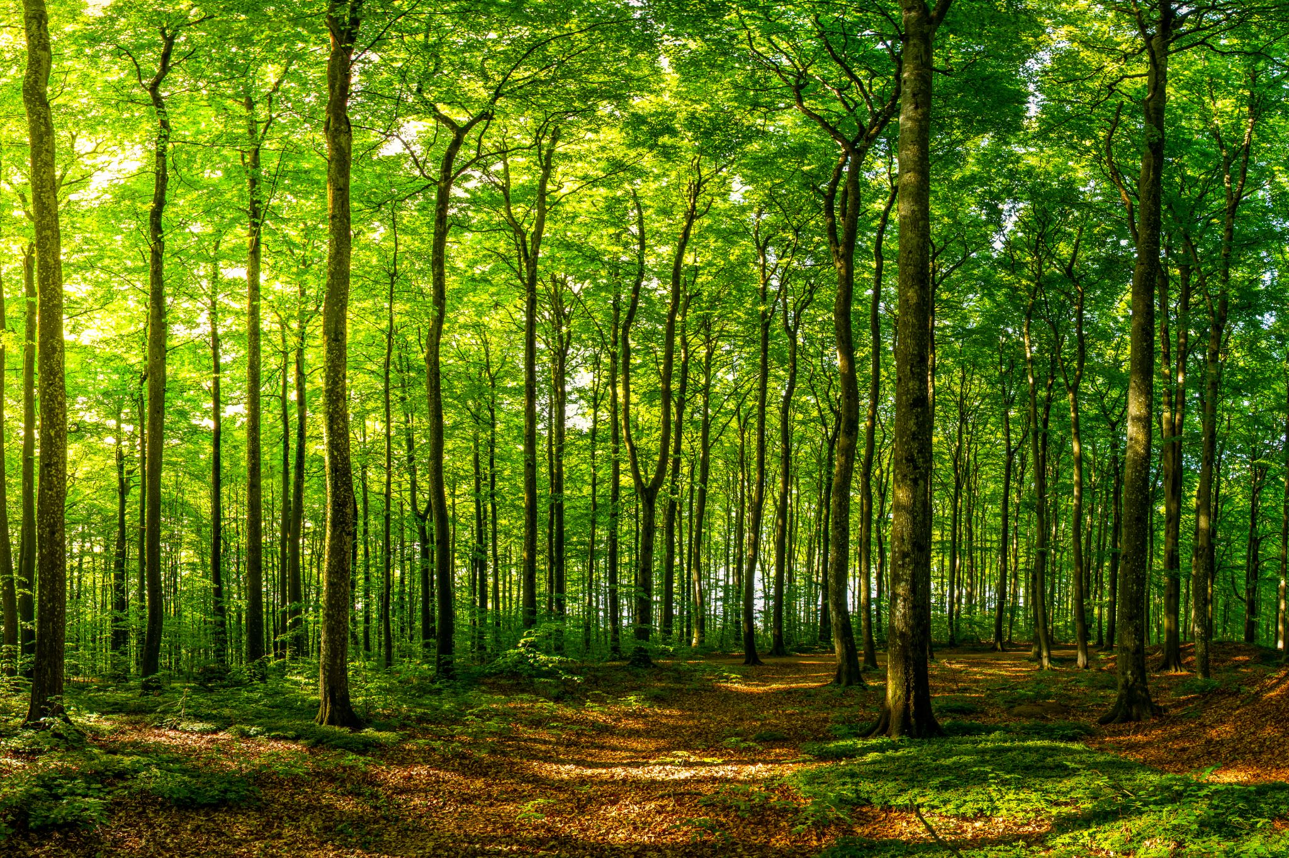
Random Forest
- Amos Chavan

Slide 2
What is a Random Forest?
A random forest is a supervised ensemble learning technique used for both classification and regression tasks.
Introduced by Leo Breiman and Adele Cutler in 2001.
It builds and combines the predictions of multiple decision trees to produce a more accurate and stable result.
Instead of relying on a single decision tree, Random Forest uses the wisdom of crowds.
By aggregating the predictions of several trees, it reduces errors due to:
Overfitting (too much focus on training data).
High variance in the model.

Slide 3
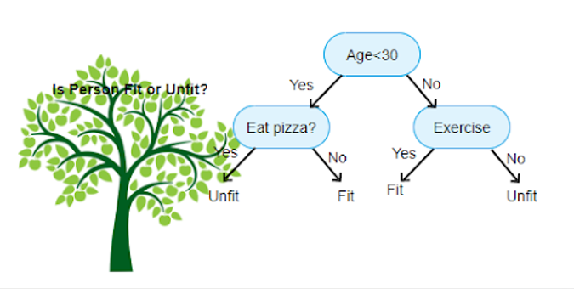
Decision Trees
It splits the data into subsets based on certain conditions, forming a tree-like structure.
They have one problem, inaccuracy. Not flexible with new data (unseen data).
While this single decision tree works well for simple problems, it may overfit or struggle with noisy data.
Random Forests improve on this by combining many such trees for better accuracy and stability.

Slide 4
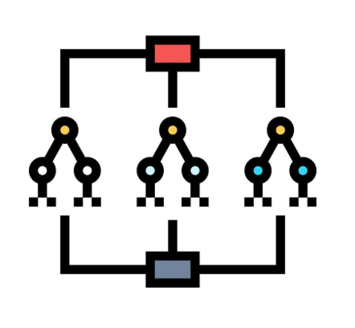

How is the data being generated for Random Forest?

Slide 5
Bootstrapping
Bootstrapping is a statistical technique where random samples are repeatedly drawn with replacement from a dataset. This means that the same data point can appear in multiple samples or not appear at all in some.
From the original dataset of size N, Random Forest randomly selects N data points with replacement to create a new subset (called a bootstrap sample).
Each bootstrap sample is used to train an individual decision tree.
Because the samples are slightly different, the trees vary, reducing overfitting.

Slide 6
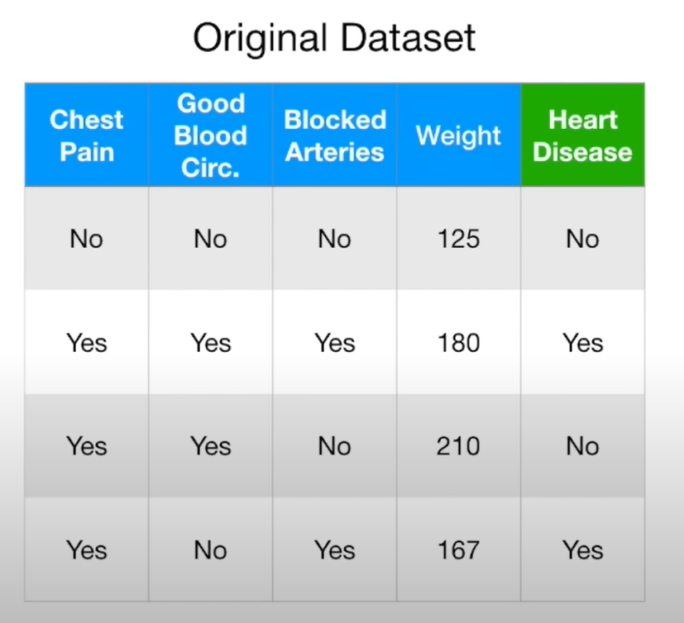
Example

Slide 7
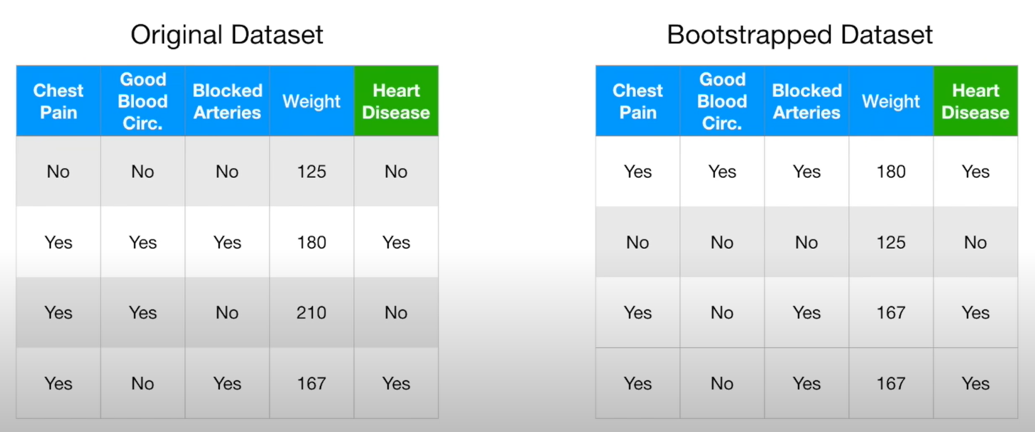

Slide 8
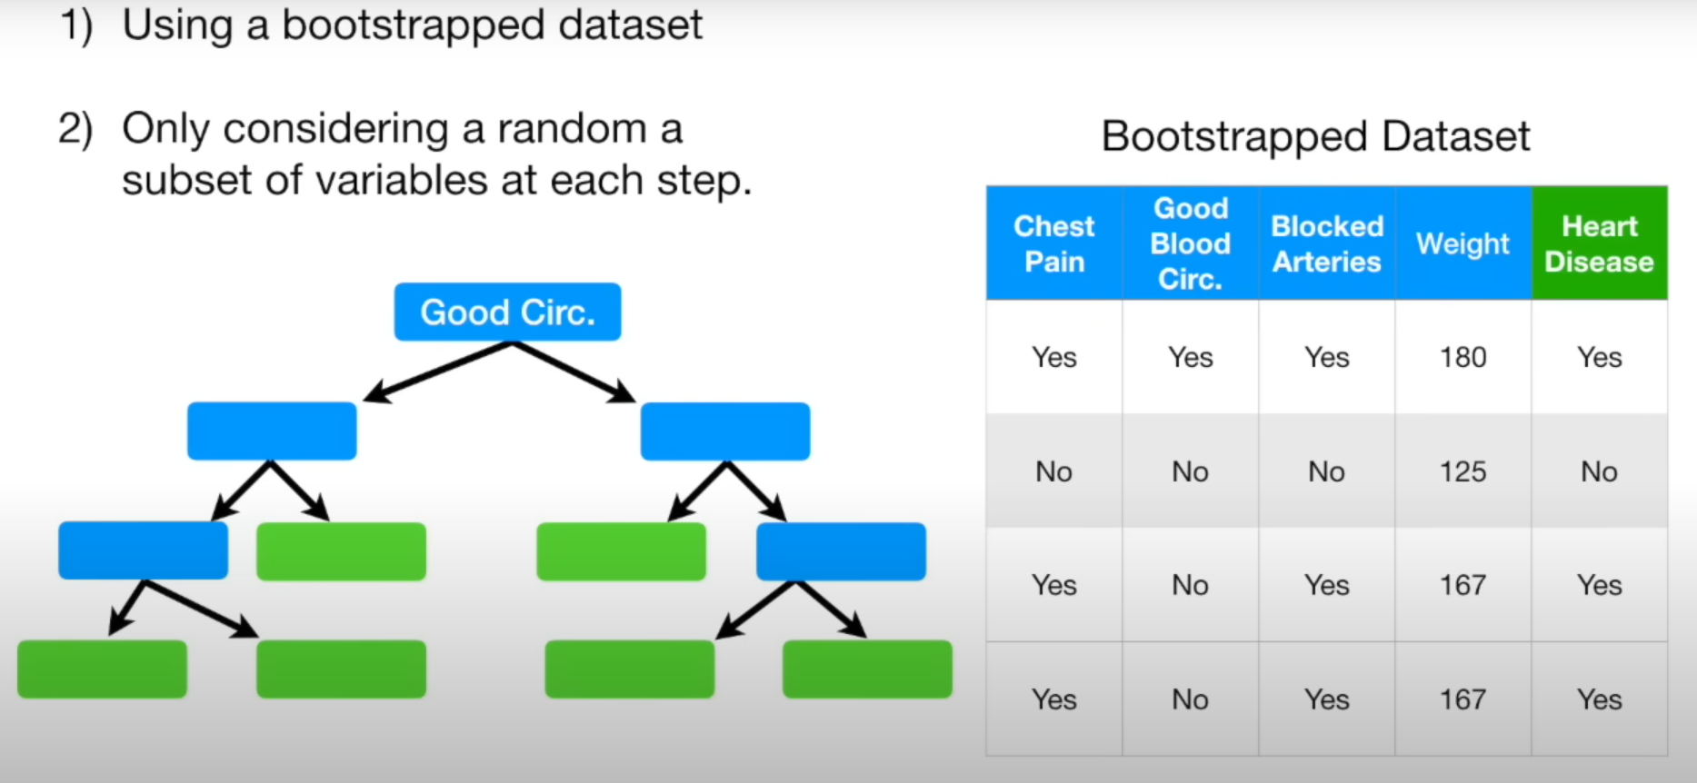
Node splitting in a random forest model is based on a random subset of features for each tree.
At each node, the algorithm selects a random subset of features from the total available features.
From this subset, the algorithm chooses the best feature to split the data at that node.

Slide 9
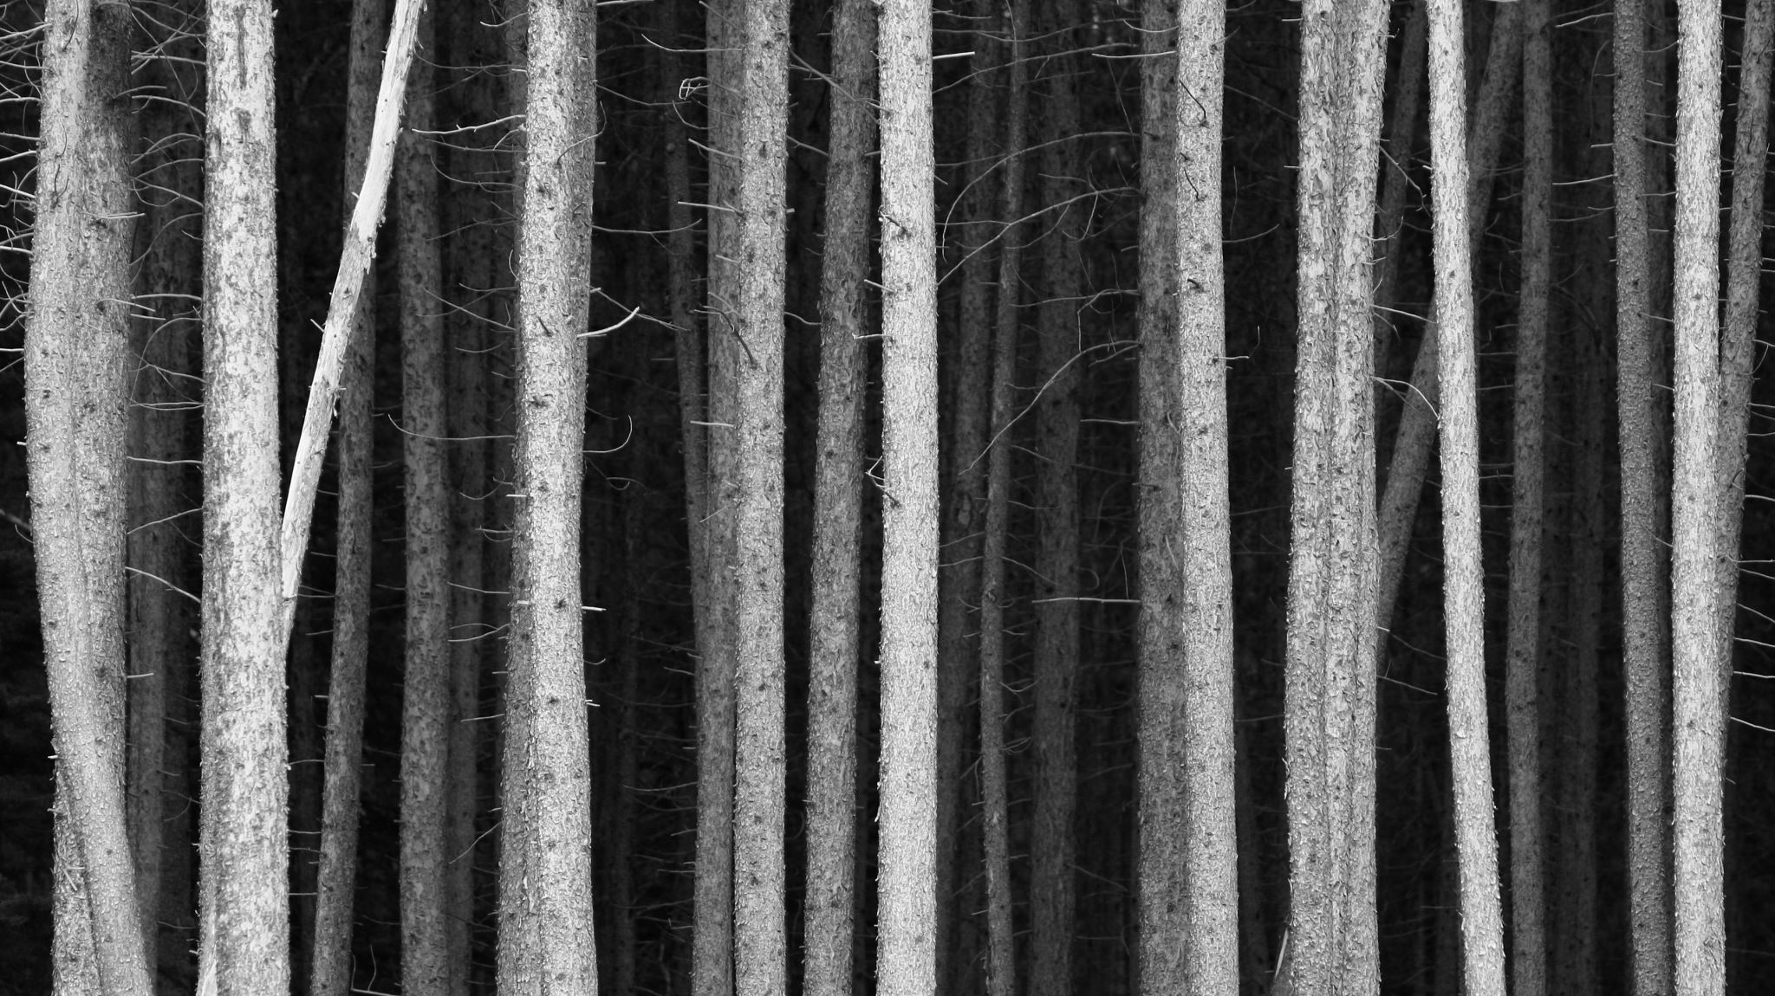
Why Use a Random Subset of Features?
Introduce Diversity:
By limiting the number of features considered at each split, Random Forest ensures that individual trees learn different patterns and are less correlated.
This reduces the risk of all trees focusing on the same dominant features.
Prevent Overfitting:
A single decision tree might overfit the data, especially when it uses all features to find the perfect splits.
Randomly selecting features makes the trees simpler and more generalized.
Enhance Ensemble Strength:
When the predictions of multiple diverse trees are aggregated (e.g., via majority voting for classification), the overall model performs better, as the errors of individual trees are less likely to align.

Slide 10
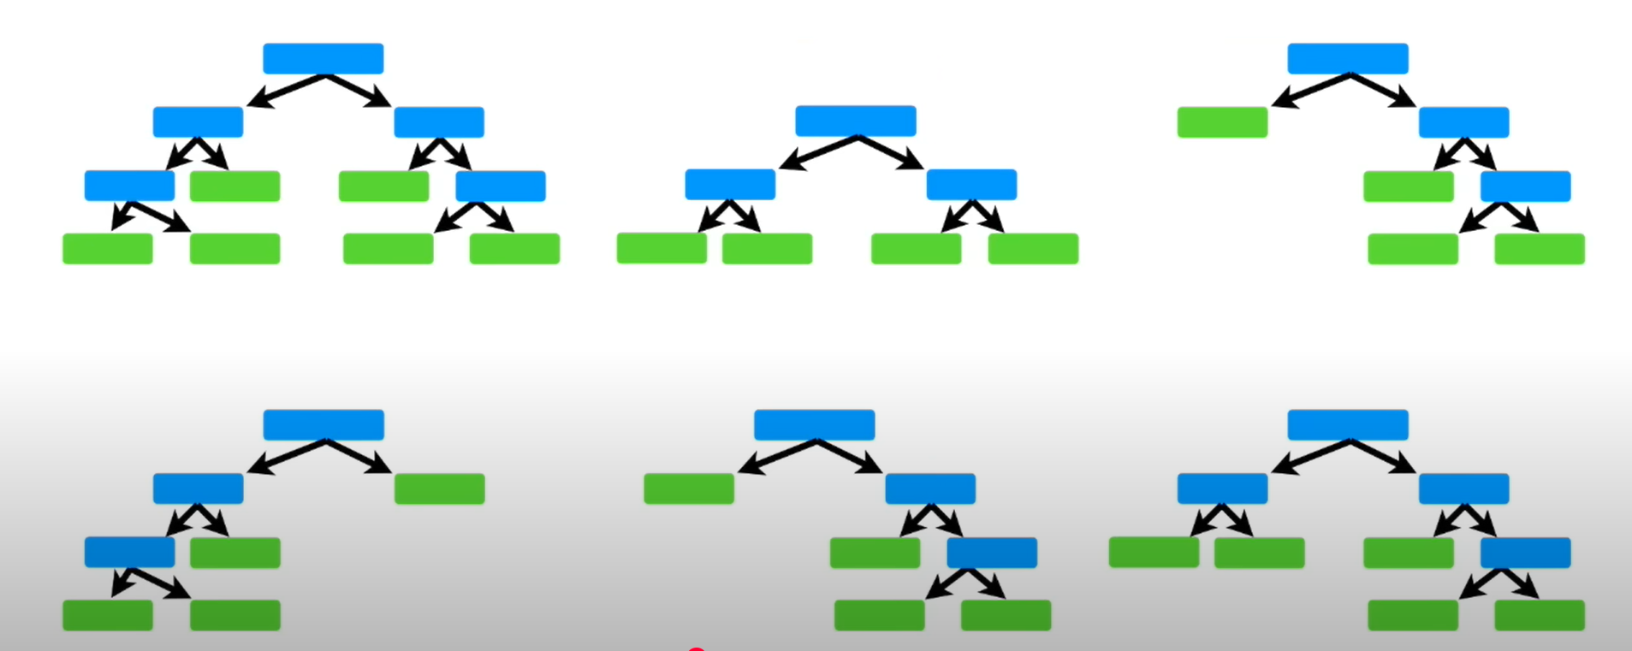

Slide 11
Prediction

Slide 12
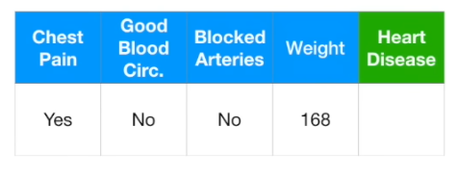

Slide 13
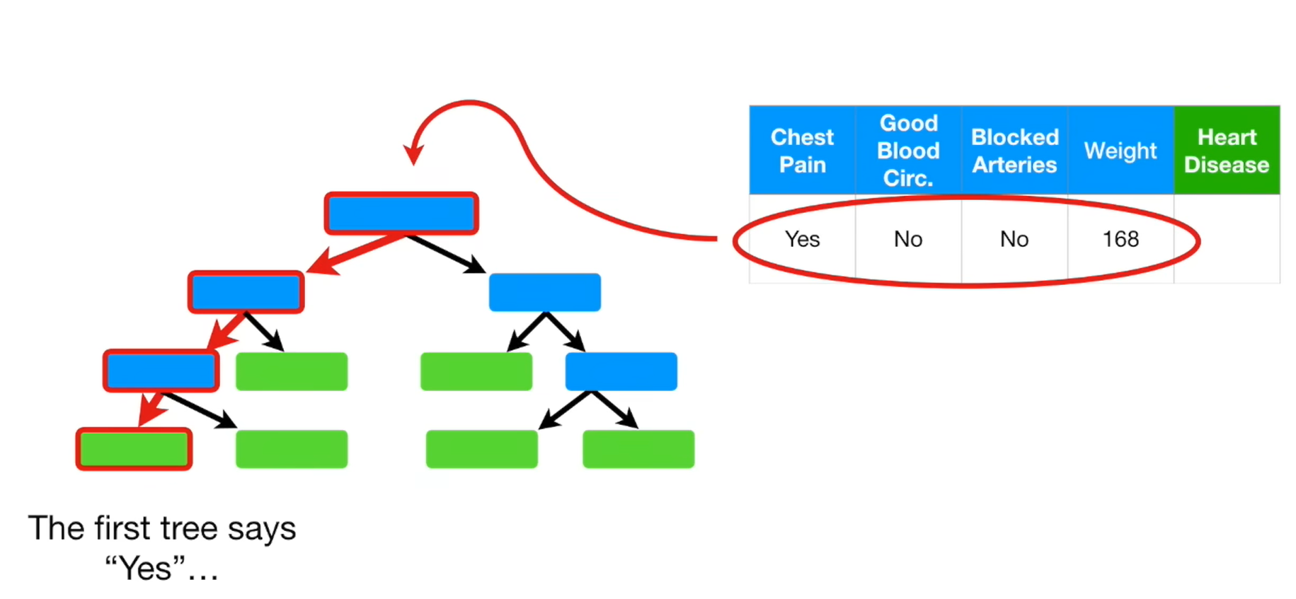

Slide 14
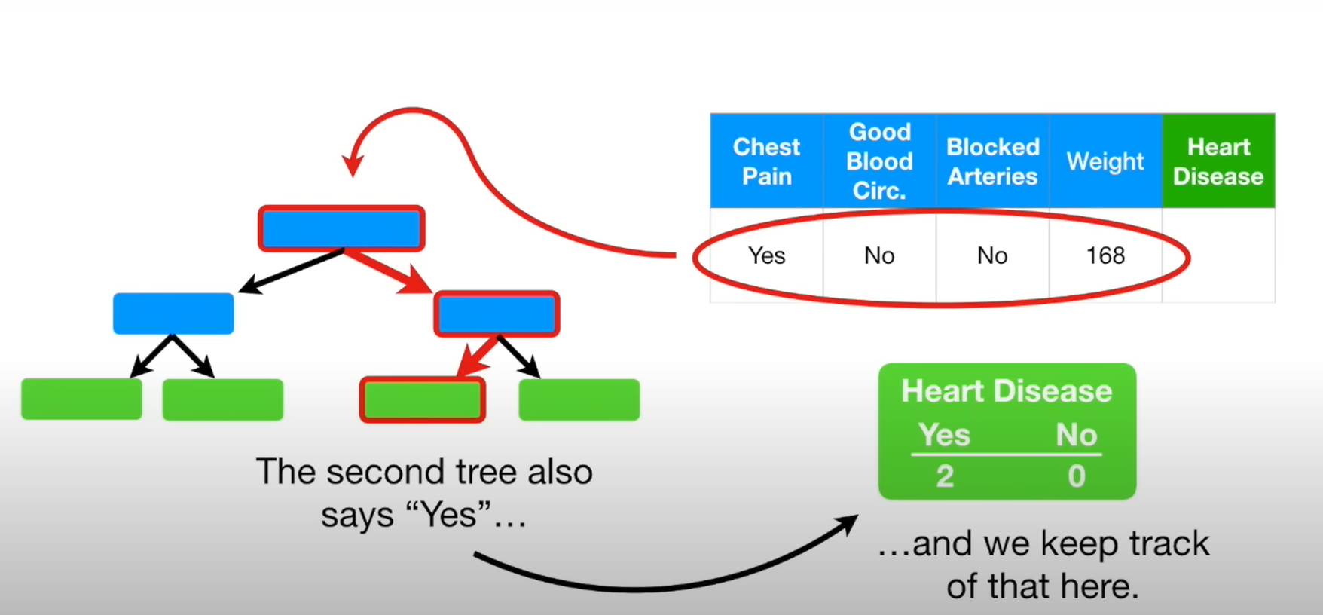

Slide 15
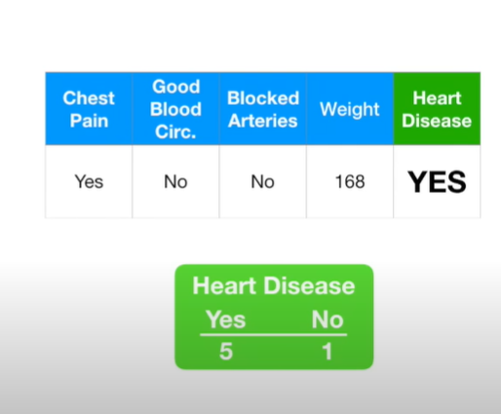

Slide 16
Bagging
Bagging, short for Bootstrap Aggregating, is an ensemble technique that combines the predictions of multiple models (usually the same type of model) to improve overall accuracy and reduce variance.
For classification, predictions are combined using majority voting (the class predicted by the most models is the final output).
For regression, predictions are combined using the average of all models’ outputs.

Slide 17
What happens to the non selected samples?

Slide 18
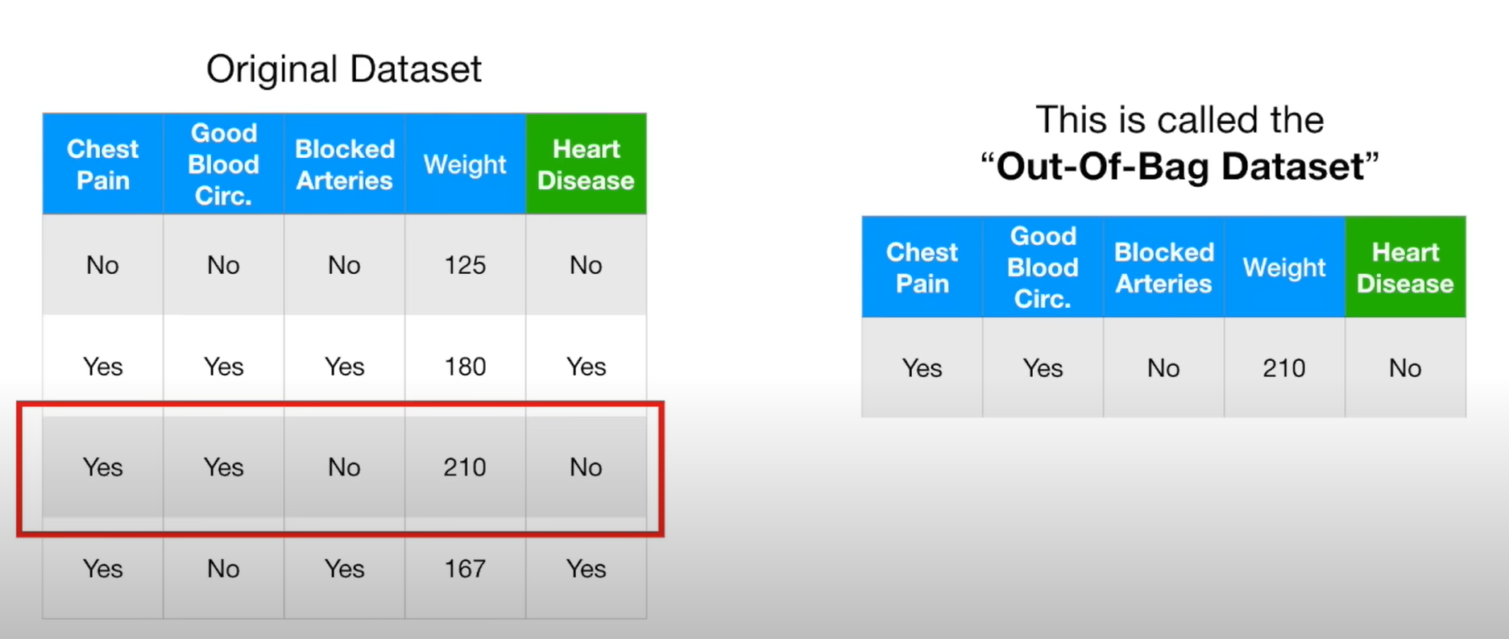

Slide 19
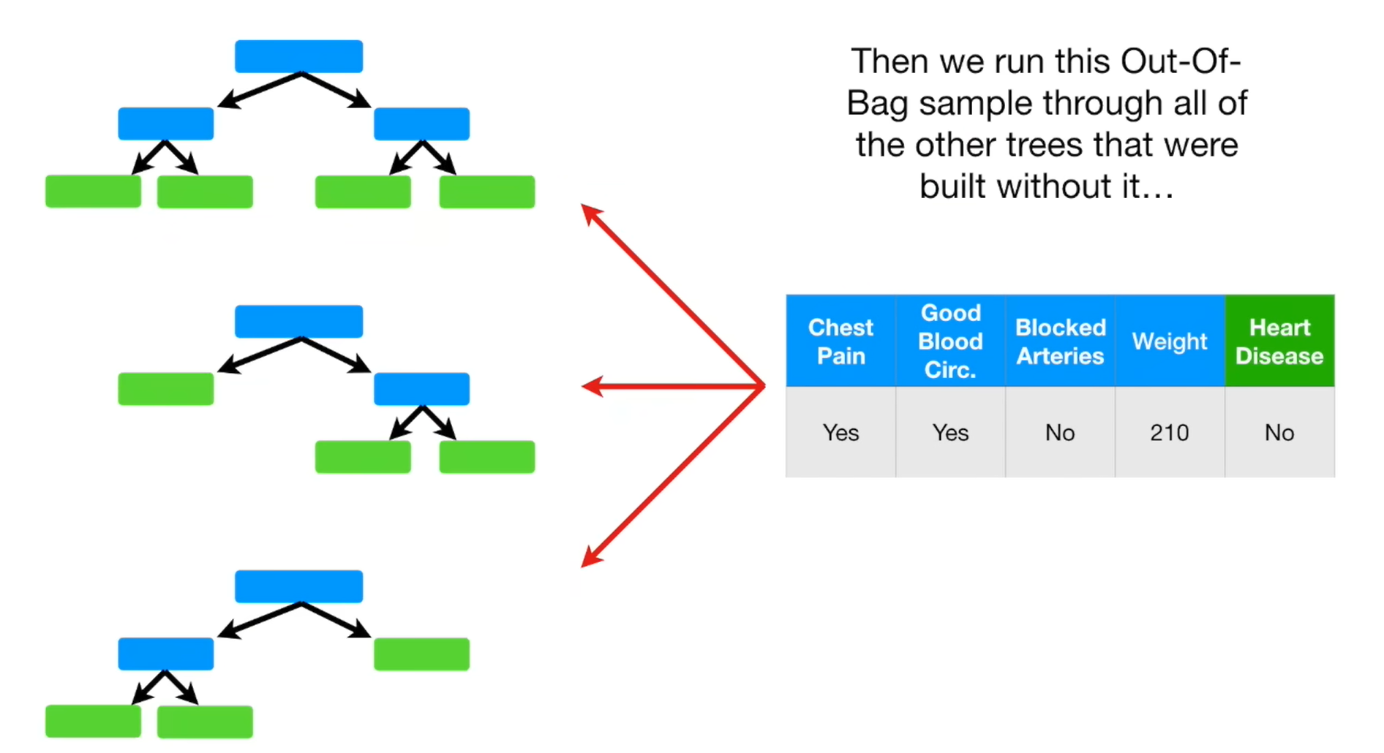
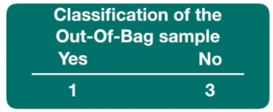

Slide 20
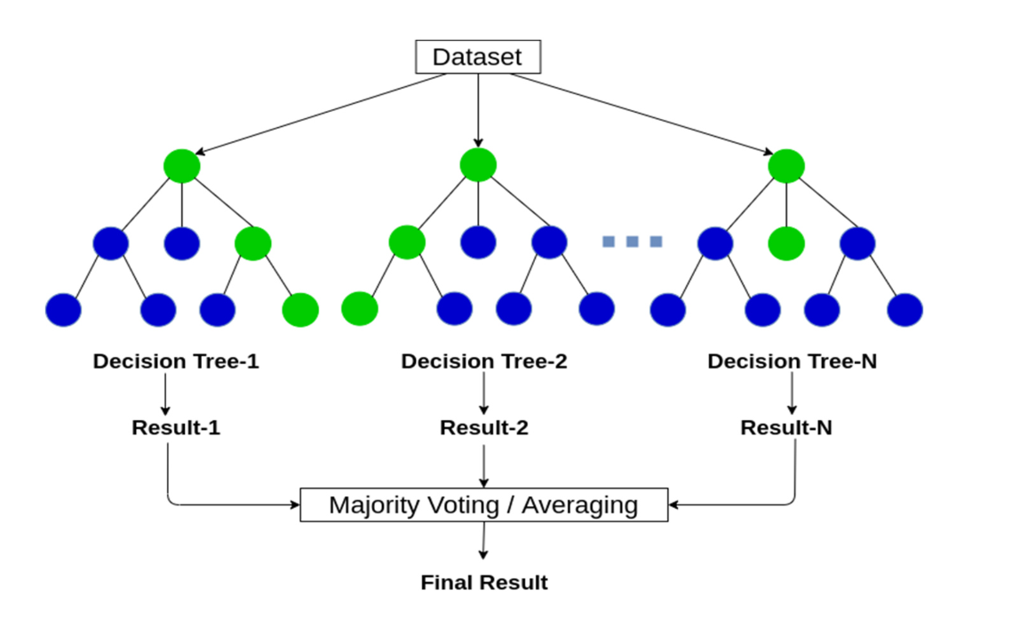
Final Flow

Slide 21

Evaluation Metrics used
Classification: If classes are imbalanced, prioritize metrics like F1-Score, ROC-AUC, or Precision/Recall.
Regression: RMSE and R^2 are commonly used, but MAE is better if outliers are a concern.
Generalization: OOB error is excellent for assessing performance without extra data splits.

Slide 22

Thank you

